Slide 1

PHANSITE
By Hadi Ibrahim

Slide 2

Outline
Application scenario
Project description
DB model
Demonstration
Challenges
Future Work

Slide 3
Application scenario
It’s December 2020. Joe Biden was elected president of the united states. Many people accused him of committing a fraud, and the USA’s general opinion about this matter is not clear, hence you’re too afraid to get out and state your opinion.
That’s the scenario that Phansite handles. It’s a social media that guarantees anonymity of the user, but also privately verifies their identity.

Slide 4

Project Description
Phansite is a website to share thoughts and discuss opinions, via open discussion posts, and weekly voting polls.

Slide 5

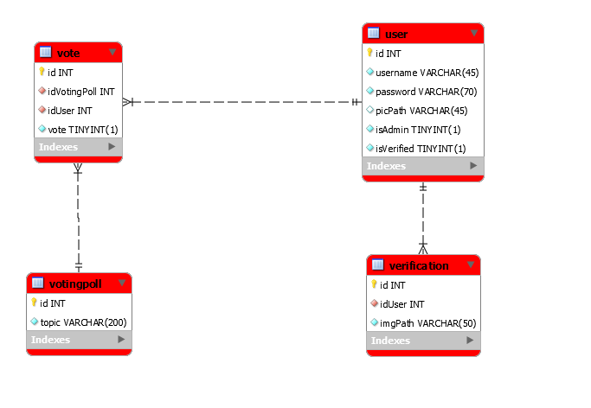
DB model

Slide 6

Demonstration
Initial landing page before sign up
It’s worthy to note that the whole
page is an HTML, relying on AJAX
and services for all functionality.

Slide 7
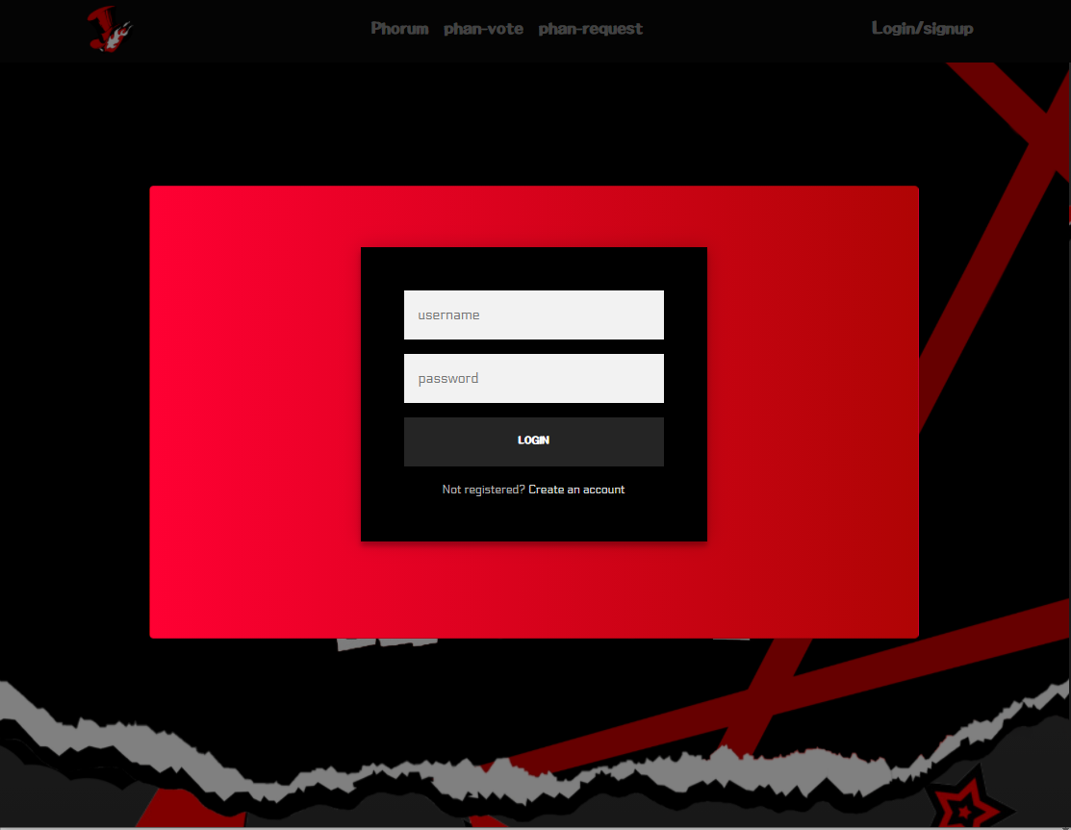
Once the user clicks on Login/signup, a modal will popup and overlay on top of the page.

Slide 8

Clicking on “Create an account” will toggle the “Sign up” form instead of the sign in form.
At any time, the user can toggle back and forth to both frames by clicking on the corresponding links.

Slide 9
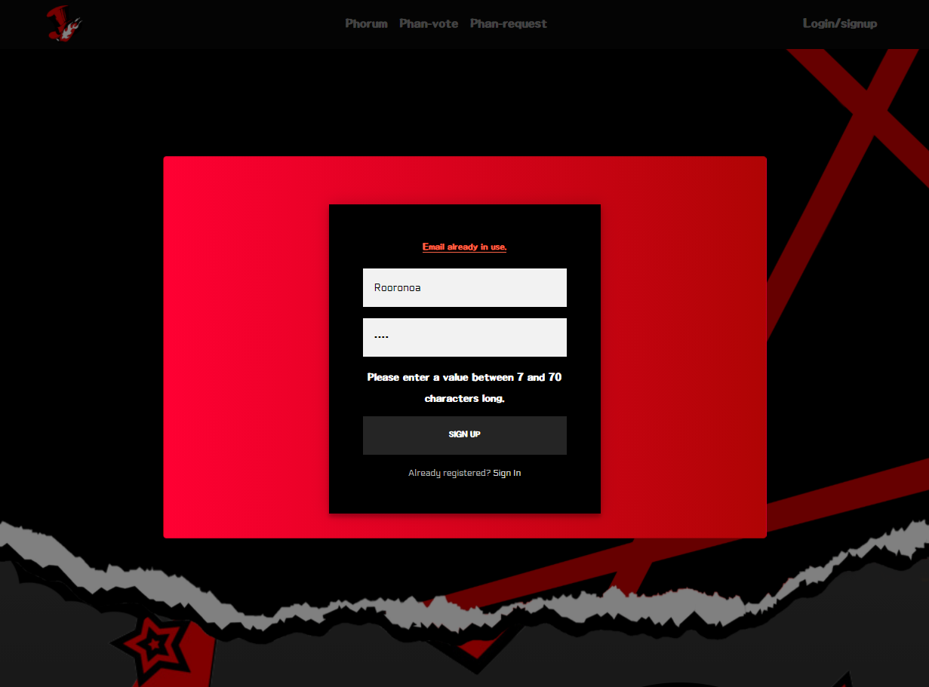
Forex validation on username and password. In addition to that, On focus out of the username, an AJAX request is sent to check if username is taken

Slide 10

On successful sign-up or sign-in validation (front end and backend), an AJAX request is sent to the server, results in creating a Session for the User in the Service Layer
UI is updated accordingly

Slide 11

Logout sends an AJAX request which removes the user from the session and reverts the UI back to the initial state.

Slide 12
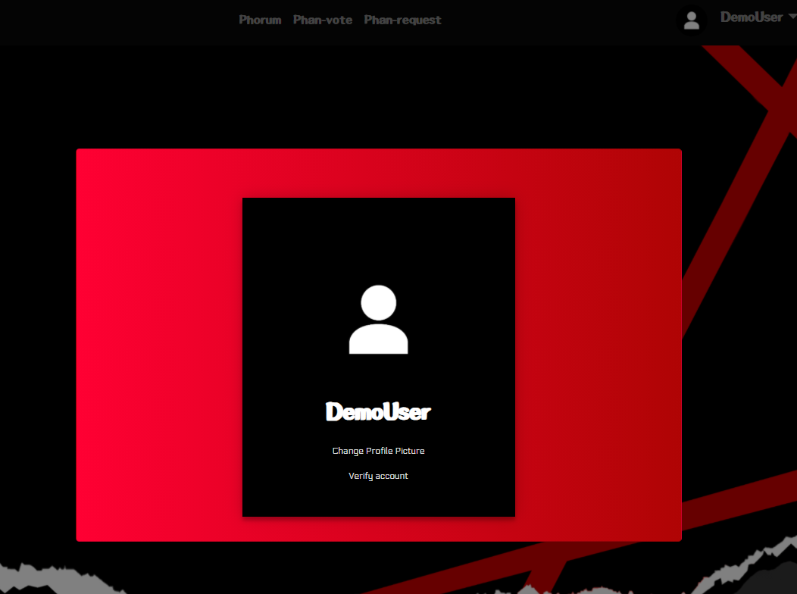
“View profile” dropdown button toggles the profile modal on and sends an AJAX to check the privileges of the user. (Admin, verified.. )
The AJAX calls also updates the UI accordingly.

Slide 13
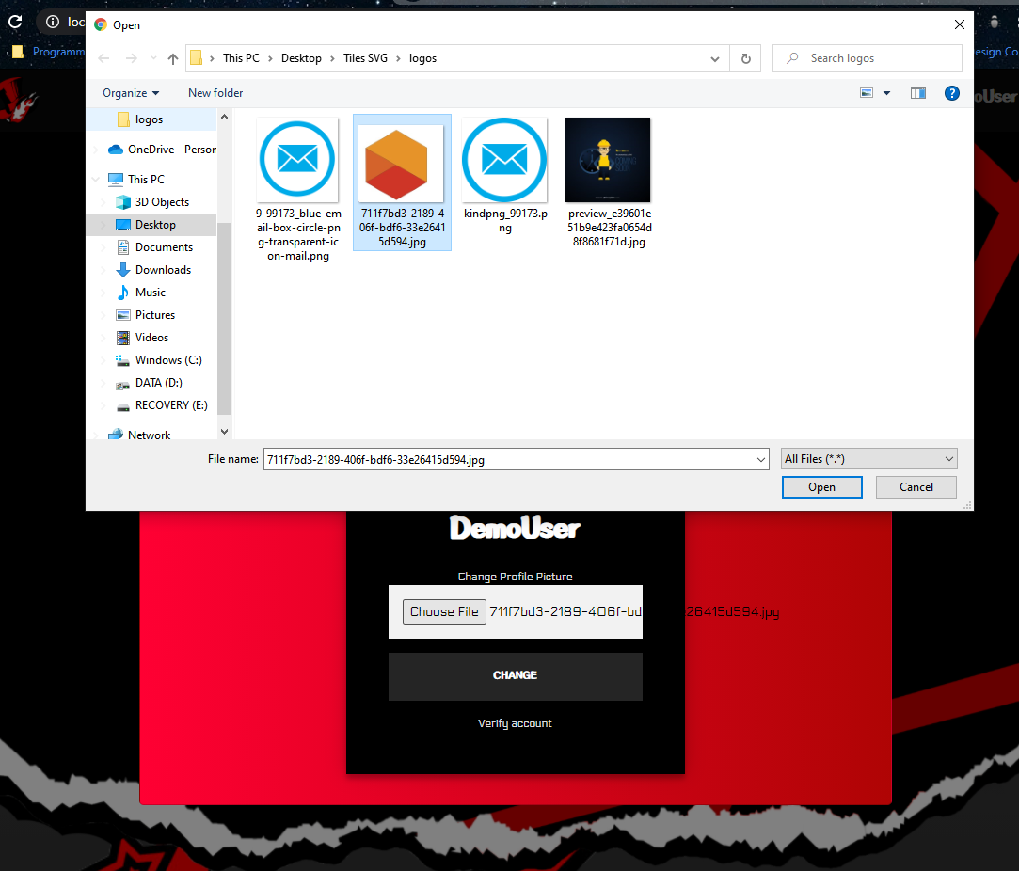
Change profile pictures gives the user the option to browse and upload the files that he wants. Once he’s done, the profile is automatically updated everywhere with an AJAX call.

Slide 14
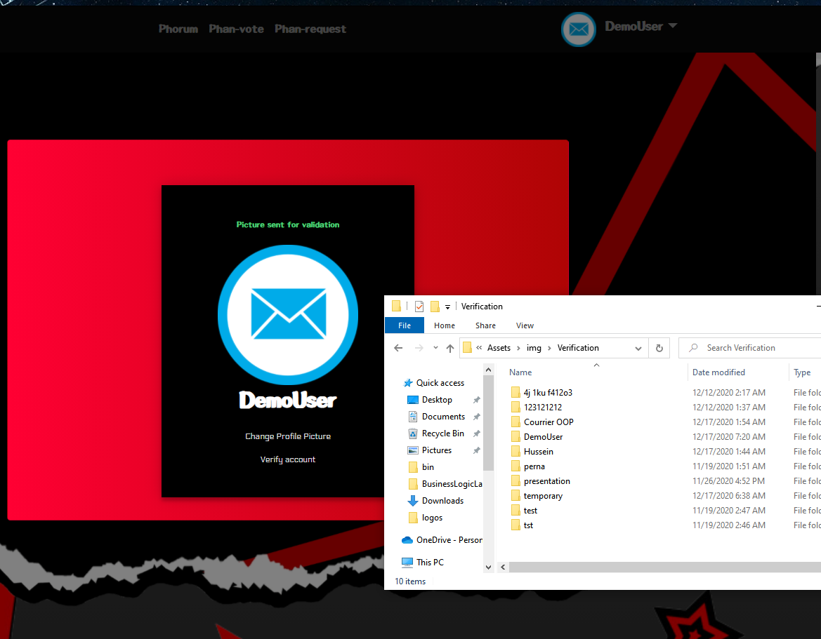
Verify account will prompt the user to do the same thing, except the output is not visible to the user. It’s for the manual verification by the admin, through the admin panel. (next slide)
Each user asking for validation gets a private folder created, in which we store the pending verifications.

Slide 15
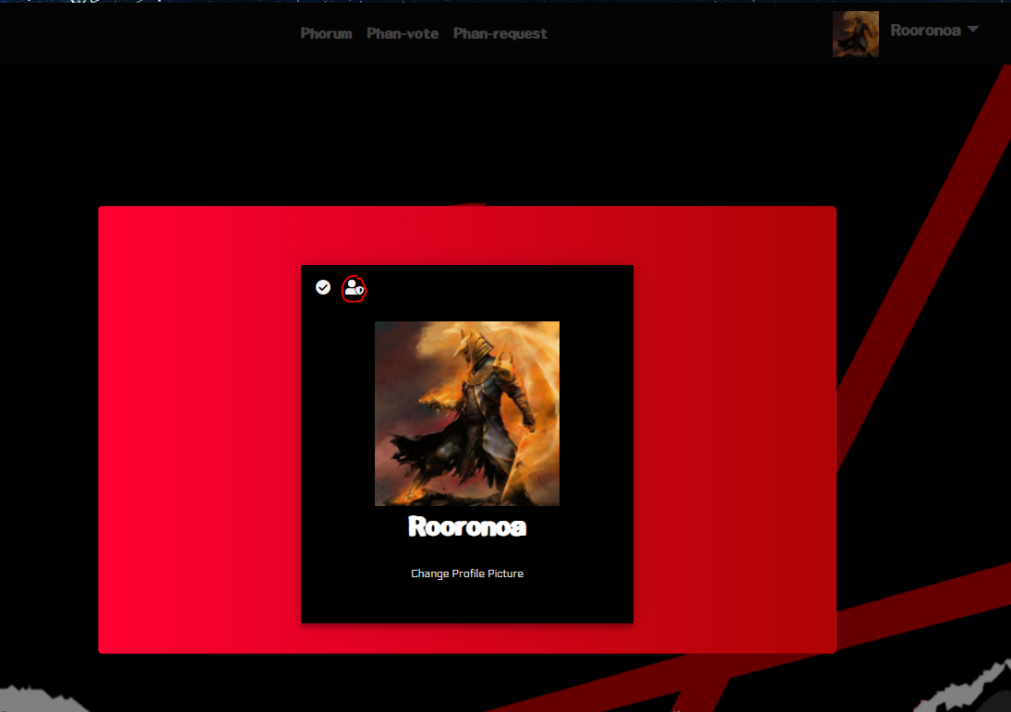
An admin can access the admin panel through his admin badge on his profile.
A verified user does not get asked
to verify his account.

Slide 16
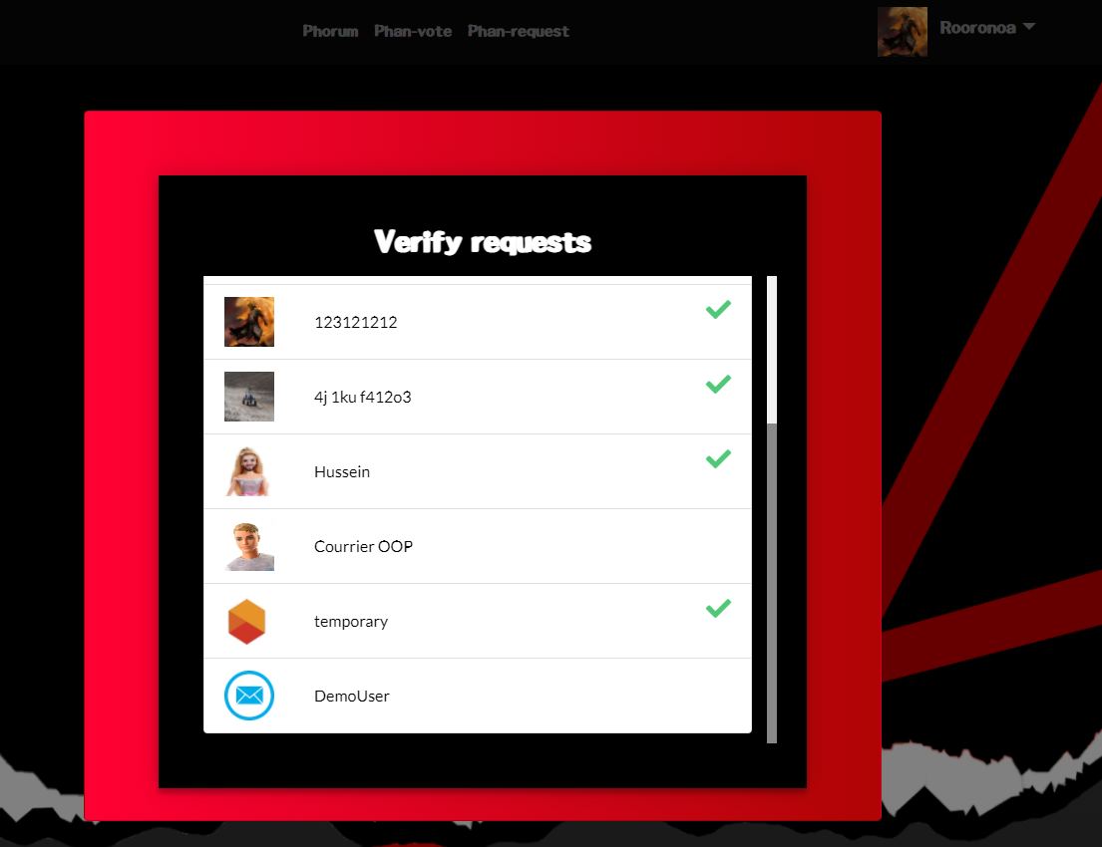
The admin panel shows a list of all verifications for users. Verified users have a green check next to their profile.
Admin can click on any user to view his verifications documents/ verify the user

Slide 17
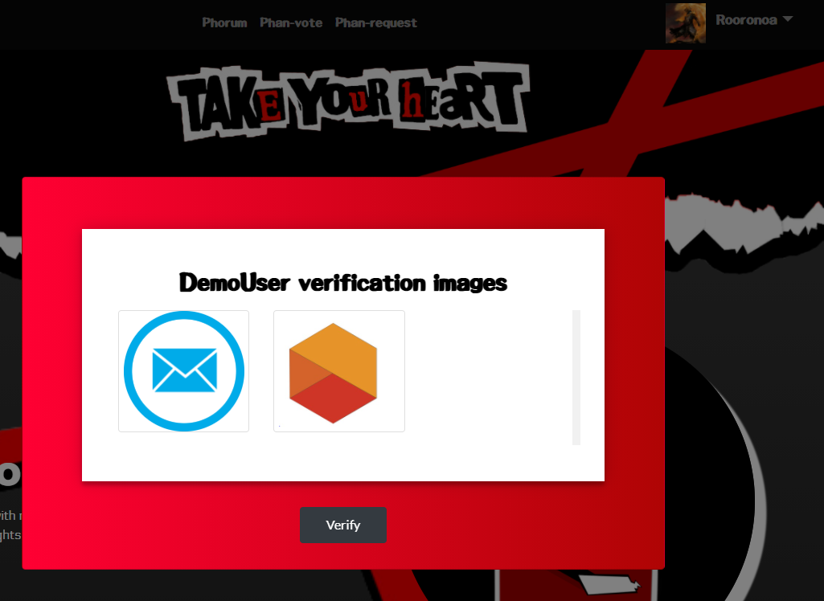
Example of the DemoUser we created earlier.

Slide 18
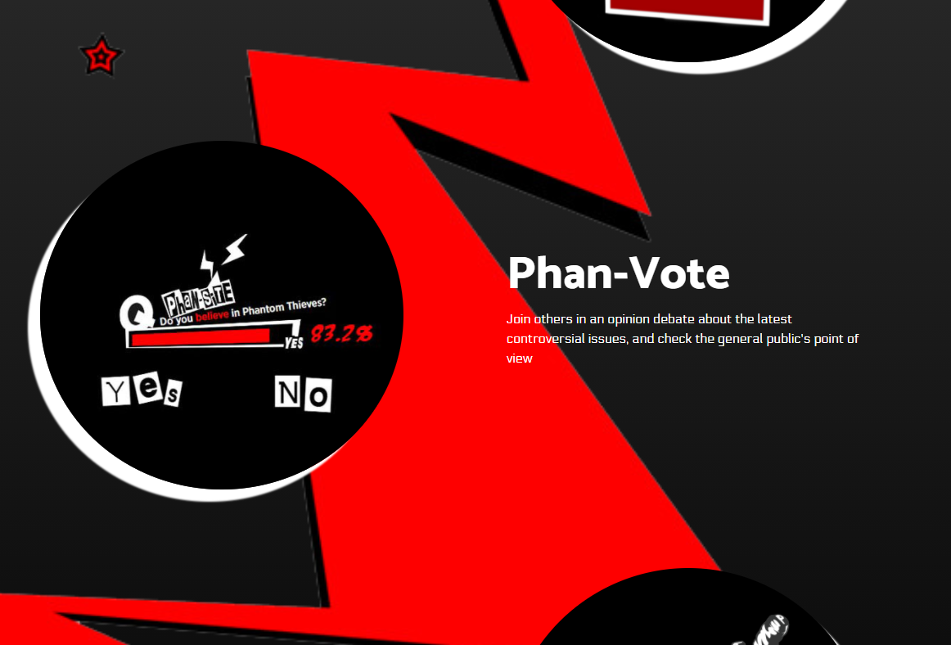
All users can access the
Phan-vote polls.

Slide 19
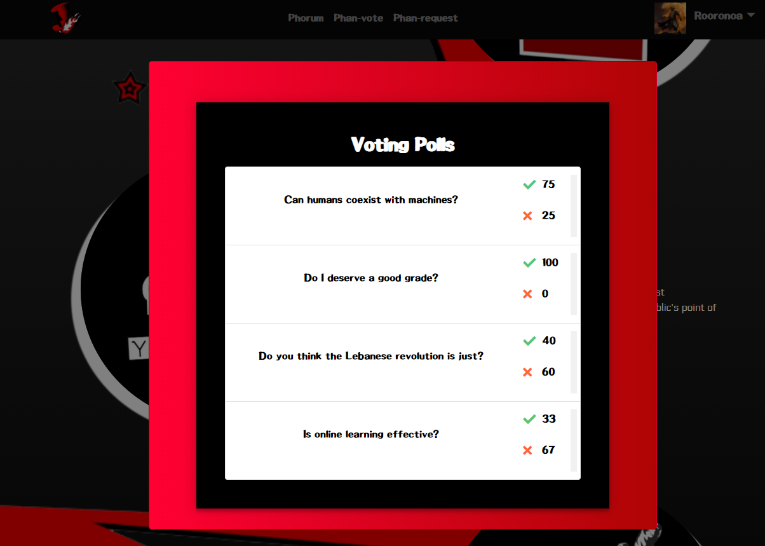
The voting polls show a brief overview of all questions in the website

Slide 20
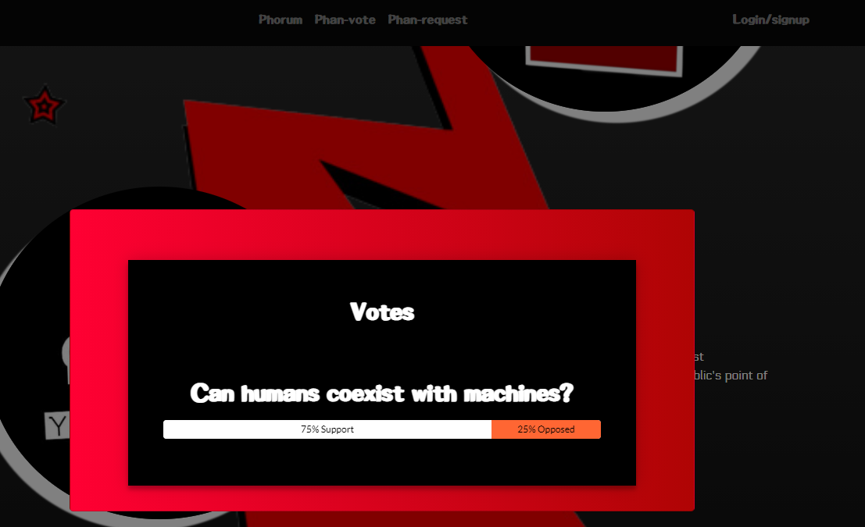
A non-logged in user, or an unverified one, can only view the results of the poll.

Slide 21
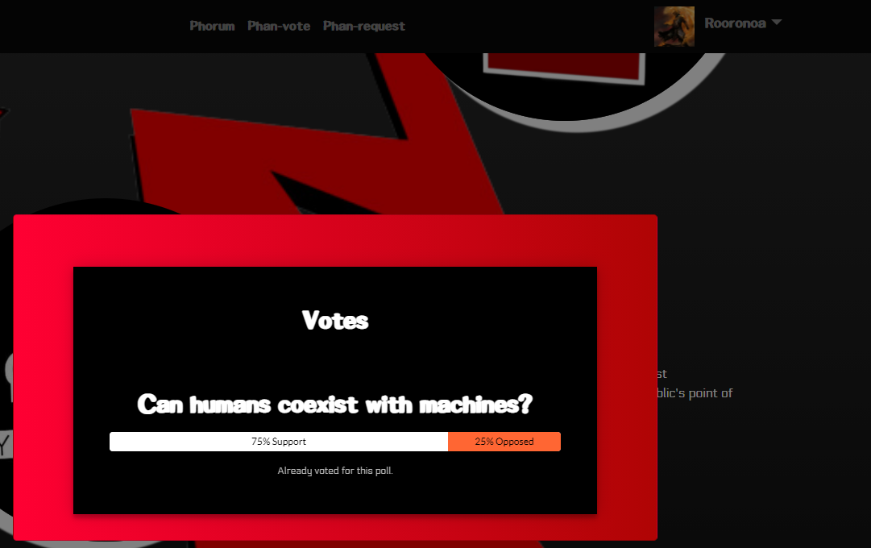
A verified user can only vote once.

Slide 22
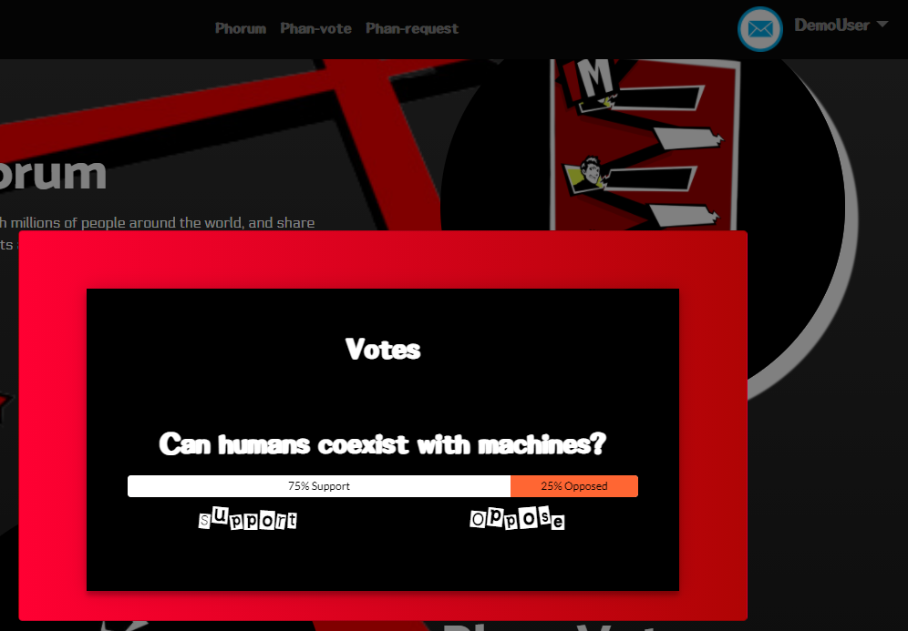
A verified user can vote for each question once. The results change live, on both panes.

Slide 23
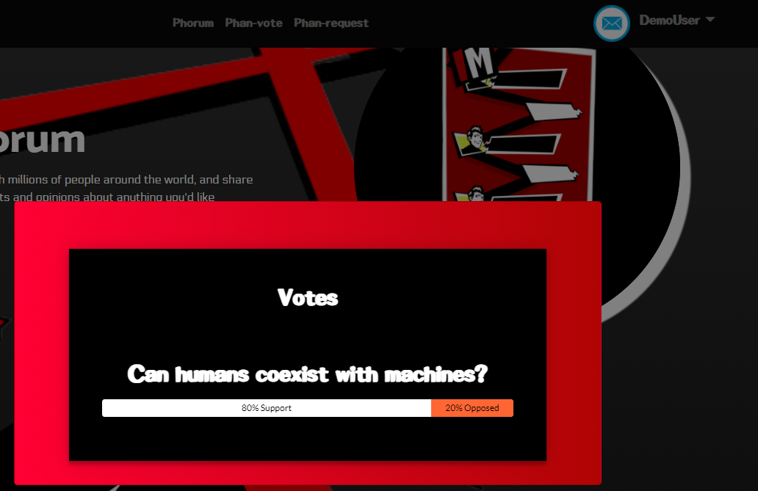
Once the user clicks on Login/signup, a modal will popup and overlay on top of the page.

Slide 24
Challenges
Designing a good UI/UX
Responsiveness
Serialization/ deserialization through different layers
Automating requests with AJAX

Slide 25
Future Work
Add more operations to the admin panel
Add live comments on votes
Implement using ASP.NET and Entity Framework
Add forum posts and up-down voting
Banning users

